Slide 1

The Cortana Intelligence Suite
Foundations – Data Preparation
Microsoft Machine Learning and Data Science Team
CortanaIntelligence.com
Notes:
Main page: http://cortanaanalytics.com
To begin this module, you should have:
Basic Math and Stats skills
Business and Domain Awareness
General Computing Background
NOTE: These workbooks contain many resources to lead you through the course, and provide a rich set of references that you can use to learn much more about these topics. If the links do not resolve properly, type the link address in manually in your web browser. If the links have changed or been removed, simply enter the title of the link in a web search engine to find the new location or a corollary reference.

Slide 2

Section 3 Learning Objectives
Understand ADF and its constructs
Implement an ADF Pipeline referencing Data Sources and with various Activities
Understand how HDInsight can be used to process data
Understand the HIVE language and how it is used
Notes:
At the end of this Module, you will:
Understand ADF and its constructs
Implement an ADF Pipeline referencing Data Sources and with various Activities
Understand how HDInsight can be used to process data
Understand the HIVE language and how it is used

Slide 3
The Data Science Process and Platform

Slide 4
The Team Data Science Process
Business Understanding
Define Objectives
Identify Data Sources
Data Acquisition and Understanding
Ingest Data
Explore Data
Modeling
Feature Selection
Create and Train Model
Deployment
Customer Acceptance
Operationalize
Testing and Validation
Update Data
Handoff
Re-train and re-score
Notes:
This process largely follows the CRISP-DM model: http://www.sv-europe.com/crisp-dm-methodology/
It also references the Cortana Intelligence process: https://azure.microsoft.com/en-us/documentation/articles/data-science-process-overview/
A complete process diagram is here: https://azure.microsoft.com/en-us/documentation/learning-paths/cortana-analytics-process/
Some walkthrough’s of the various services: https://azure.microsoft.com/en-us/documentation/articles/data-science-process-walkthroughs/
An integrated process and toolset allows for a more close-to-intent deployment
Iterations are required to close in on the solution – but are harder tio management and monitor
Data Science Blog: https://buckwoody.wordpress.com/

Slide 5
The Cortana Intelligence Platform
Cortana, Cognitive Services, Bot Framework
Power BI
HDInsight
Stream Analytics
Azure Machine Learning (MRS)
SQL Data Warehouse (SQL DB, Document DB)
Data Lake
Event Hubs
Data Factory
Data Catalog
Microsoft Azure
Notes:
Platform and Storage: Microsoft Azure – http://microsoftazure.com Storage: https://azure.microsoft.com/en-us/documentation/services/storage/ (Host It)
Azure Data Catalog: http://azure.microsoft.com/en-us/services/data-catalog (Doc It)
Azure Data Factory: http://azure.microsoft.com/en-us/services/data-factory/ (Move It)
Azure Event Hubs: http://azure.microsoft.com/en-us/services/event-hubs/ (Bring It)
Azure Data Lake: http://azure.microsoft.com/en-us/campaigns/data-lake/ (Store It)
Azure DocumentDB: https://azure.microsoft.com/en-us/services/documentdb/ , Azure SQL Data Warehouse: http://azure.microsoft.com/en-us/services/sql-data-warehouse/ (Relate It)
Azure Machine Learning: http://azure.microsoft.com/en-us/services/machine-learning/ (Learn It)
Azure HDInsight: http://azure.microsoft.com/en-us/services/hdinsight/ (Scale It)
Azure Stream Analytics: http://azure.microsoft.com/en-us/services/stream-analytics/ (Stream It)
Power BI: https://powerbi.microsoft.com/ (See It)
Cortana: http://blogs.windows.com/buildingapps/2014/09/23/cortana-integration-and-speech-recognition-new-code-samples/ and https://blogs.windows.com/buildingapps/2015/08/25/using-cortana-to-interact-with-your-customers-10-by-10/ and https://developer.microsoft.com/en-us/Cortana (Say It)
Cognitive Services: https://www.microsoft.com/cognitive-services
Bot Framework: https://dev.botframework.com/
All of the components within the suite: https://www.microsoft.com/en-us/server-cloud/cortana-intelligence-suite/what-is-cortana-intelligence.aspx
What can I do with it? https://gallery.cortanaintelligence.com/
Getting Started Quickly: https://caqs.azure.net/#gallery

Slide 6
Module 1: Data Selection, Processing and Transformation
Notes:
Depends on the customer - https://www.microsoft.com/en-us/cloud-platform/cortana-intelligence-suite-industry-solutions

Slide 7
Business Case
AdventureWorks is a company that makes and sells bicycles. The sales are conducted around the world. We also support our products. But as we’ve made more sales in the last 10 years, we’ve farmed out the support function to various companies that take in maintenance and support issues in call centers around the world.
We’re growing. And now we want to take our bicycles to several large retailers, but a few of them want to know a lot about our churn rate.
For over 10 years, we’ve collected a lot of information about our customers and of course we know a lot about our products. But since we’ve outsourced our call centers, we don’t own the databases that hold their data – they will give us an export, though. (They support multiple customers)
We’re not sure about our churn rate – we have the data of who has and has not bought again, and we think we can get the data from the call centers for the complaints and repairs, but we need a way to analyze a lot of data that has different formats to find a prediction of who will churn and who will not.
Ideally we want a list of customers we think will churn, in a structured database we could share out to our potential resellers sales staff, so they know how to target at-risk and new clients.
More on our in-house data: https://technet.microsoft.com/en-us/library/ms124501%28v=sql.100%29.aspx
Notes:
AdventureWorks Data Dictionary: https://technet.microsoft.com/en-us/library/ms124438(v=sql.100).aspx

Slide 8
Business Case
AdventureWorks is a company that makes and sells bicycles. The sales are conducted around the world. We also support our products. But as we’ve made more sales in the last 10 years, we’ve farmed out the support function to various companies that take in maintenance and support issues in call centers around the world.
We’re growing. And now we want to take our bicycles to several large retailers, but a few of them want to know a lot about our churn rate.
For over 10 years, we’ve collected a lot of information about our customers and of course we know a lot about our products. But since we’ve outsourced our call centers, we don’t own the databases that hold their data – they will give us an export, though. (They support multiple customers)
We’re not sure about our churn rate – we have the data of who has and has not bought again, and we think we can get the data from the call centers for the complaints and repairs, but we need a way to analyze a lot of data that has different formats to find a prediction of who will churn and who will not.
Ideally we want a list of customers we think will churn, in a structured database we could share out to our potential resellers sales staff, so they know how to target at-risk and new clients.
More on our in-house data: https://technet.microsoft.com/en-us/library/ms124501%28v=sql.100%29.aspx
Notes:
AdventureWorks Data Dictionary: https://technet.microsoft.com/en-us/library/ms124438(v=sql.100).aspx

Slide 9
Module 2: HDInsight for Data Manipulation and Processing
Notes:
Processing, querying, and transforming data using HDInsight: https://msdn.microsoft.com/en-us/library/dn749822.aspx

Slide 10

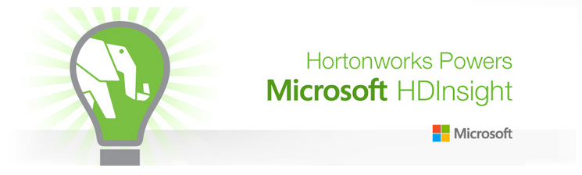
Hadoop and HDInsight
Using the Hadoop Ecosystem to process and query data
Notes:
Primary site: https://azure.microsoft.com/en-us/services/hdinsight/
Quick overview: https://azure.microsoft.com/en-us/documentation/articles/hdinsight-hadoop-introduction/
4-week online course through the edX platform: https://www.edx.org/course/processing-big-data-azure-hdinsight-microsoft-dat202-1x
11 minute introductory video: https://channel9.msdn.com/Series/Getting-started-with-Windows-Azure-HDInsight-Service/Introduction-To-Windows-Azure-HDInsight-Service
Microsoft Virtual Academy Training (4 hours) - https://mva.microsoft.com/en-US/training-courses/big-data-analytics-with-hdinsight-hadoop-on-azure-10551?l=UJ7MAv97_5804984382
Learning path for HDInsight: https://azure.microsoft.com/en-us/documentation/learning-paths/hdinsight-self-guided-hadoop-training/
Azure Feature Pack for SQL Server 2016, i.e., SSIS (SQL Server Integration Services): https://msdn.microsoft.com/en-us/library/mt146770(v=sql.130).aspx

Slide 11

Hadoop
An ecosystem of components for distributed data processing and analysis
Core components: MapReduce, HDFS, YARN
Data is processed in the Hadoop Distributed File System (HDFS)
Resource Management is performed by YARN
Many other related projects
Notes:
Introduction Document: https://azure.microsoft.com/en-us/documentation/articles/hdinsight-hadoop-introduction/
For more information about Hadoop, visit the apache foundation site: http://hadoop.apache.org/

Slide 12
HDInsight and the Hadoop Zoo Ecosystem
Visual Studio Tools
C#, F#, .NET
GraphX/GraphFrames
Spark SQL
Data Integration
(ODBC / SQOOP/ REST)
Core Hadoop
Pipeline / workflow
(Oozie)
Graph
(Pegasus)
Stats processing
(RHadoop)
Machine Learning
(Mahout)
Relational
(SQL Server)
MLLib/ Spark ML
Metadata
(HCatalog)
PDW Polybase
Data Processing
Real Time Processing (Storm)
NoSQL Database
(HBase)
Scripting
(Pig)
Query
(Hive)
Event Driven Processing
Microsoft Integration
Distributed Processing
(MapReduce)
Event Pipeline
(Event Hub/ Flume)
Business Intelligence
(Excel, Power BI, SSAS)
Microsoft R Server (Enterprise R in the Cloud)
Data Movement
YARN
Distributed Storage (HDFS)
Monitoring & Deployment (System Center)
World's Data (Azure Data Marketplace)
Azure Blob Storage
Active Directory (Security)
ML Packages
Notes:
Full training example for the local HDP Instance: http://hortonworks.com/hadoop-tutorial/hello-world-an-introduction-to-hadoop-hcatalog-hive-and-pig/
More detail on the Hadoop Components: http://www.datasciencecentral.com/profiles/blogs/hadoop-herd-when-to-use-what
Hcatalog – exposes hive metadata to other applications, giving users a relational view of HDFS data
Hbase - A non-relational (NoSQL) database that runs on top of HDFS, random-realtime reads of HDFS data
Polybase - PolyBase is a technology that accesses and combines both non-relational and relational data, all from within SQL Server. It allows you to run queries on external data in Hadoop or Azure blob storage. The queries are optimized to push computation to Hadoop
https://msdn.microsoft.com/en-us/library/mt143171.aspx

Slide 13
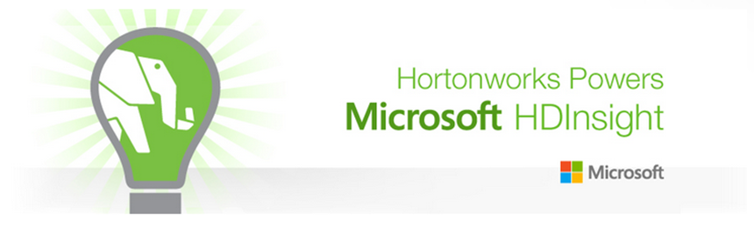
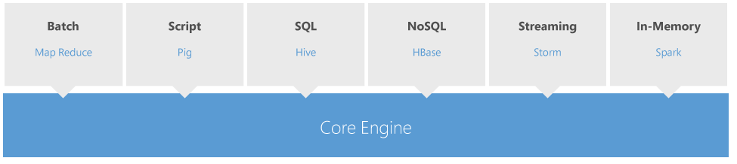
HDInsight
3 Modes: VM, Service, On-Demand
Azure Storage or Azure Data Lake provides the HDFS layer
Azure SQL Database stores metadata
Notes:
Main page: https://azure.microsoft.com/en-us/documentation/services/hdinsight/
Pricing for HDInsight: https://azure.microsoft.com/en-us/pricing/details/hdinsight/
On demand HDInsight cluster: https://azure.microsoft.com/en-us/documentation/articles/data-factory-compute-linked-services/#azure-hdinsight-on-demand-linked-service

Slide 14
Deprecation of HDInsight on Windows
HDI 3.3 is the last version of HDInsight on Windows
HDI 3.3 will be deprecated on July 31st 2017 *
Refer this to help migrate your customer to HDInsight on Linux
Impact: Post Deprecation (i.e. after July 31st 2017)
You will not be able to create a HDInsight cluster on Windows
You will not be able to resize an existing HDInsight on Windows cluster
* Deprecation time may vary by region.

Slide 15
Deploying HDInsight Clusters
Cluster Type: Hadoop, Spark, R Server, HBase, Kafka, Storm, Hive LLAP
Operating System: Windows or Linux
Can be deployed from Azure portal, ARM Templates, Azure Command Line Interface (CLI), or Azure PowerShell
Cluster Management through Ambari UI and REST API
Remote Access through SSH, REST API, ODBC, JDBC.
Premium Features: Secure Hadoop and Apache Ranger for Multi-User Administration
Notes:
Azure Portal: http://azure.portal.com
Provisioning Clusters: https://azure.microsoft.com/en-us/documentation/articles/hdinsight-provision-clusters/
Different clusters have different node types, number of nodes, and node sizes.

Slide 16
Using Hive to Query Data
Hive is a higher-level abstraction of MapReduce.
It provides a structure for highly unstructured data by delivering metadata service that projects tabular schemas over folders.
Enables the contents of folders to be queried as though they were tables.
It provides a SQL-like query semantics that are translated into Tez or MapReduce jobs (no need to write Java or MapReduce!).
Not a relational database.
Persistent data through Azure Blob Storage.
Notes:
Hive for HDInsight: https://azure.microsoft.com/en-us/documentation/articles/hdinsight-use-hive/
Referencing user defined functions with Hive: https://msdn.microsoft.com/en-us/library/dn749875.aspx?f=255&MSPPError=-2147217396
Using Apache Tez for improved performance: https://azure.microsoft.com/en-us/documentation/articles/hdinsight-use-hive/#usetez

Slide 17



Hive architecture
Built on top of Hadoop to provide data management, querying, and analysis
Access and query data through simple SQL-like statements, called Hive queries
In short, Hive compiles, Hadoop executes
ODBC
JDBC
Hive web interface (HWI)
Command line interface (CLI)
Metastore
Hive
Thrift server
Compiler, Optimizer, Executor
Hadoop
Head node
Name node
Data nodes/task nodes
Notes:
Hive for HDInsight: https://azure.microsoft.com/en-us/documentation/articles/hdinsight-use-hive/
Referencing user defined functions with Hive: https://msdn.microsoft.com/en-us/library/dn749875.aspx?f=255&MSPPError=-2147217396
Using Apache Tez for improved performance: https://azure.microsoft.com/en-us/documentation/articles/hdinsight-use-hive/#usetez

Slide 18
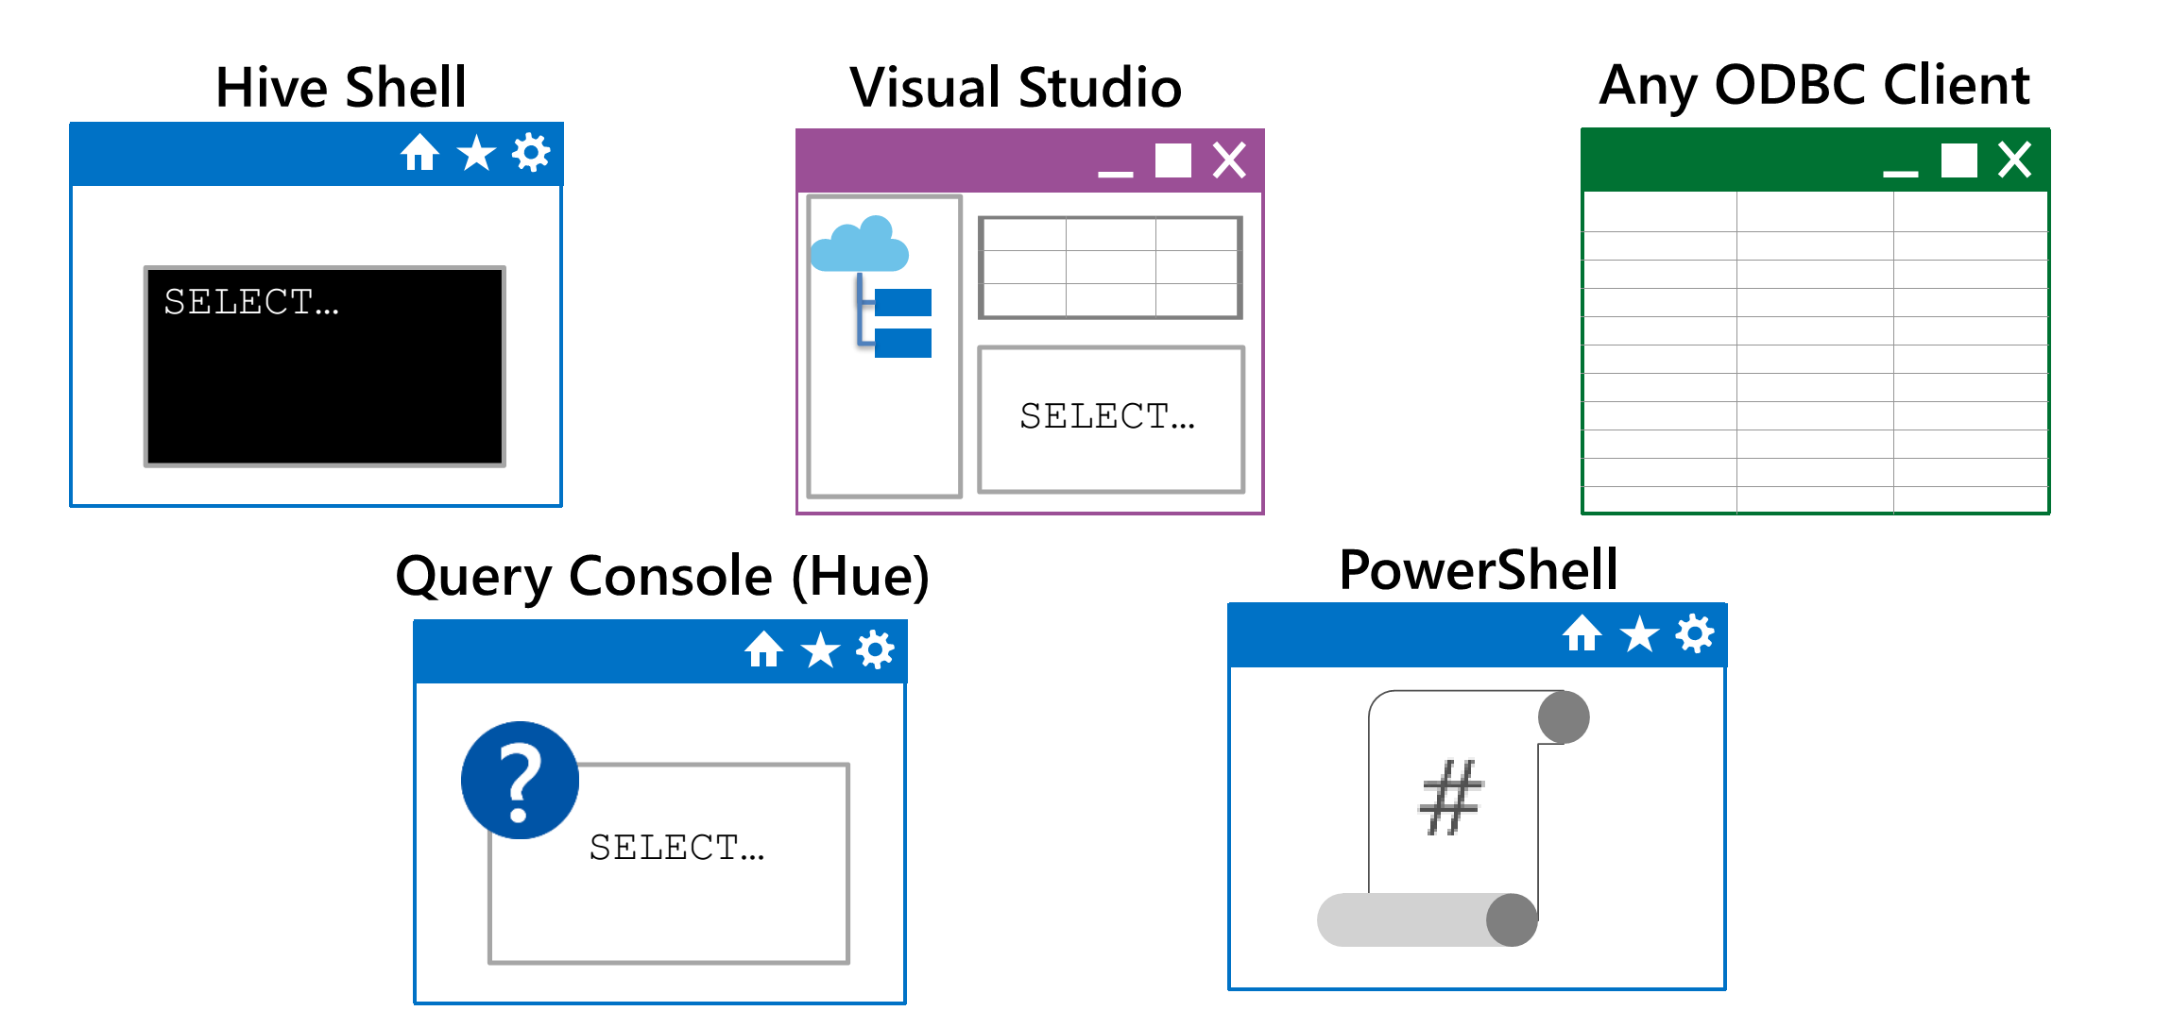
Hive Client Tools
You can submit Hive Jobs using many different tools
Notes:
https://azure.microsoft.com/en-us/documentation/articles/hdinsight-connect-excel-hive-odbc-driver/

Slide 19


Create, load, and query Hive tables
HiveQL includes data definition language, data import/export and data manipulation language statements
Create table
Import data into Hive table
Query data using SQL-like statement
Notes:
1. Full tutorial on creating Hive Tables: https://www.dezyre.com/hadoop-tutorial/apache-hive-tutorial-tables

Slide 20
Module 3: Azure Data Factory
Notes:
Primary Site: https://azure.microsoft.com/en-us/services/data-factory/
2-minute overview video: https://channel9.msdn.com/Blogs/Windows-Azure/Introduction-to-Azure-Data-Factory/

Slide 21

Azure Data Factory
Create, orchestrate, and manage data movement and enrichment through the cloud
Notes:
Learning Path: https://azure.microsoft.com/en-us/documentation/articles/data-factory-introduction/
Developer Reference: https://msdn.microsoft.com/en-us/library/azure/dn834987.aspx

Slide 22
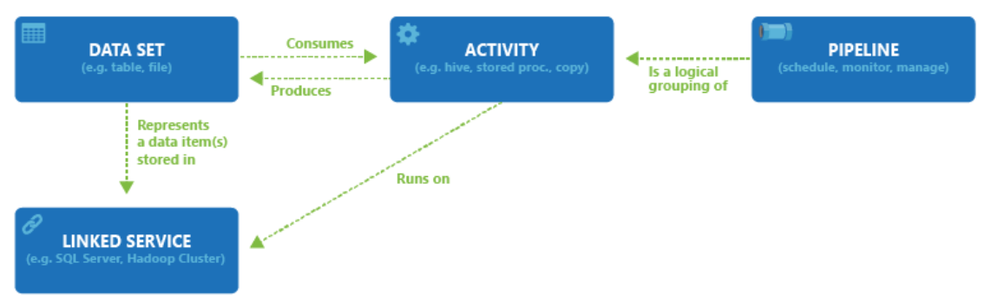
ADF Components
Notes:
Pricing: https://azure.microsoft.com/en-us/pricing/details/data-factory/

Slide 23
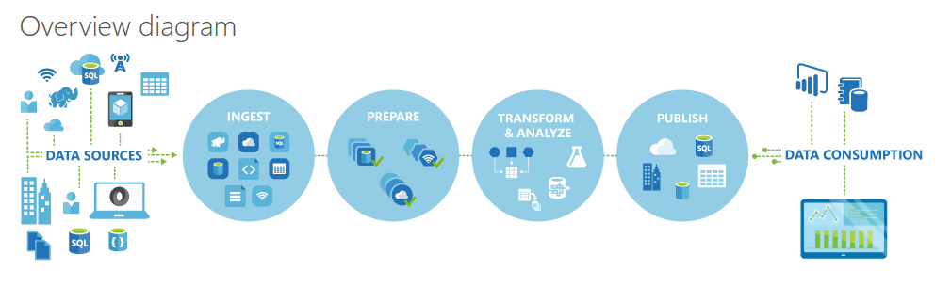
ADF Logical Flow
Notes:
Learning Path: https://azure.microsoft.com/en-us/documentation/articles/data-factory-introduction/
Quick Example: http://azure.microsoft.com/blog/2015/04/24/azure-data-factory-update-simplified-sample-deployment/

Slide 24
ADF Process
Define Architecture: Set up objectives and flow
Create the Data Factory: Portal, PowerShell, VS
Create Linked Services: Connections to Data and Services
Create Datasets: Input and Output
Create Pipeline: Define Activities
Monitor and Manage: Portal or PowerShell, Alerts and Metrics
Notes:
Full Tutorial: https://azure.microsoft.com/en-us/documentation/articles/data-factory-build-your-first-pipeline/

Slide 25
1. Design Process
Define data sources, processing requirements, and output – also management and monitoring
Notes:
https://azure.microsoft.com/en-us/documentation/articles/data-factory-customer-profiling-usecase/

Slide 26






Example - Churn
Azure Data
Factory:
Data Set
(Collection of files, DB table, etc)
Activity: a processing step
(Hadoop job, custom code, ML model, etc)
Pipeline: a logical group of activities
Data Sources
Ingest
Transform & Analyze
Publish
Call Log Files
Call Log Files
Transform, Combine, etc
Analyze
Move
Act (Visualize)
Customer Table
Customer Table
On Premises
Data Mart
Customer Call Details
Customers Likely to Churn
Customer Churn Table
Azure Blob Storage
Azure DB
Notes:
Video of this process: https://azure.microsoft.com/en-us/documentation/videos/azure-data-factory-102-analyzing-complex-churn-models-with-azure-data-factory/

Slide 27
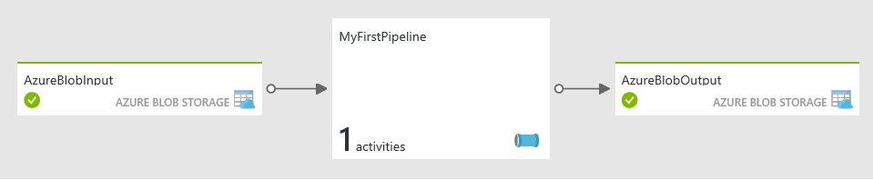

Simple ADF:
Business Goal: Transform and Analyze Web Logs each month
Design Process: Transform Raw Weblogs, using a Hive Query, storing the results in Blob Storage
Files ready for analysis and use in AzureML
HDInsight HIVE query to transform Log entries
Web Logs Loaded to Blob
Notes:
More options: Prepare System: https://azure.microsoft.com/en-us/documentation/articles/data-factory-build-your-first-pipeline-using-editor/ - Follow steps
Another Lab: https://azure.microsoft.com/en-us/documentation/articles/data-factory-samples/

Slide 28
2. Create the Data Factory
Portal, PowerShell and Visual Studio
Notes:
Setting Up: https://azure.microsoft.com/en-us/documentation/articles/data-factory-build-your-first-pipeline/

Slide 29
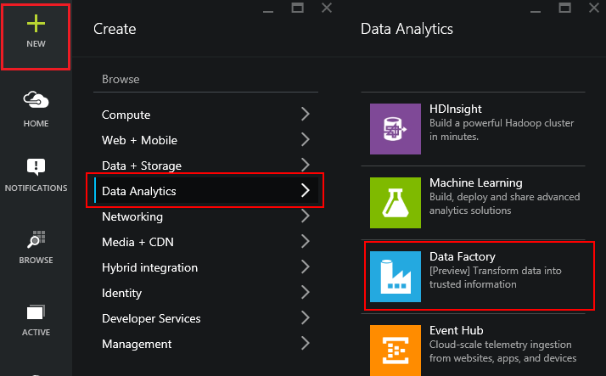
Using the Portal
Use in Non-MS Clients
Use for Exploration
Use when teaching or in a Demo
Notes:
Overview: https://azure.microsoft.com/en-us/documentation/articles/data-factory-build-your-first-pipeline/
Using the Portal: https://azure.microsoft.com/en-us/documentation/articles/data-factory-build-your-first-pipeline-using-editor/

Slide 30
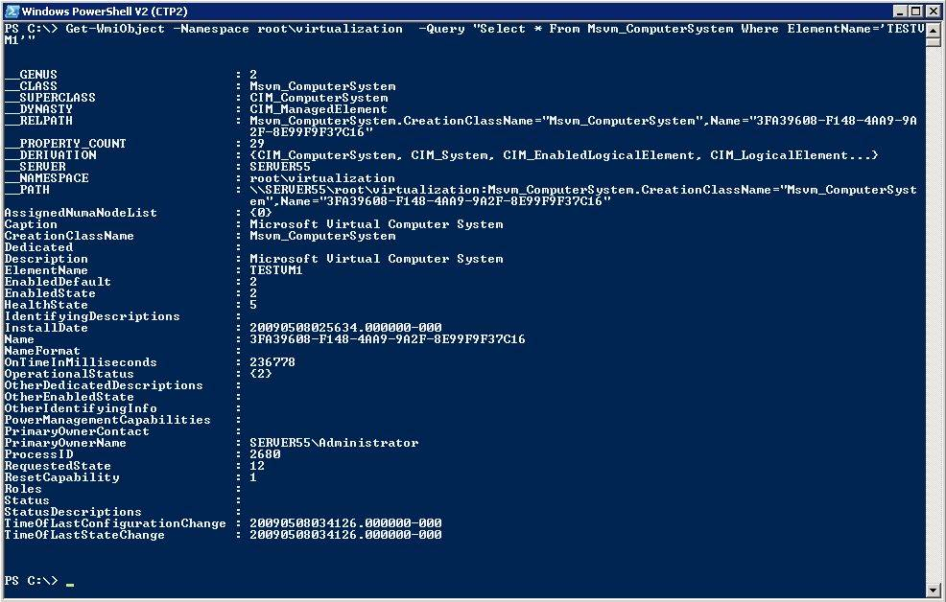
Using PowerShell
Use in MS Clients
Use for Automation
Use for quick set up and tear down
Notes:
Learning Path: https://azure.microsoft.com/en-us/documentation/articles/data-factory-introduction/
Full Tutorial: https://azure.microsoft.com/en-us/documentation/articles/data-factory-build-your-first-pipeline/

Slide 31
PowerShell ADF Example
Run Add-AzureAccount and enter the user name and password
Run Get-AzureSubscription to view all the subscriptions for this account.
Run Select-AzureSubscription to select the subscription that you want to work with.
Run Switch-AzureMode AzureResourceManager
Run New-AzureResourceGroup -Name ADFTutorialResourceGroup -Location "West US"
Run New-AzureDataFactory -ResourceGroupName ADFTutorialResourceGroup –Name DataFactory(your alias)Pipeline –Location "West US"
Notes:
https://azure.microsoft.com/en-us/documentation/articles/data-factory-build-your-first-pipeline-using-powershell/

Slide 32
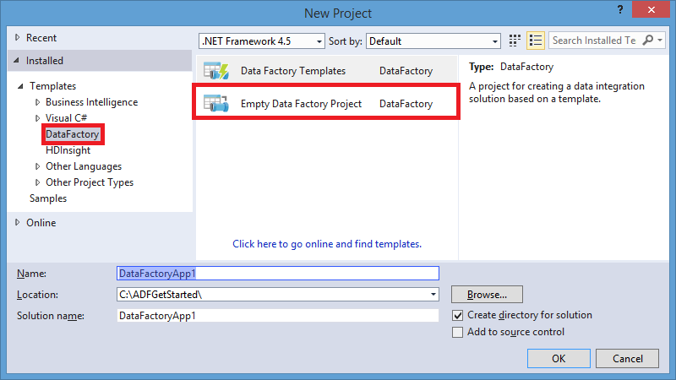
Using Visual Studio
Use in mature dev environments
Use when integrated into larger development process
Notes:
Overview: https://azure.microsoft.com/en-us/documentation/articles/data-factory-build-your-first-pipeline/
Using the Portal: https://azure.microsoft.com/en-us/documentation/articles/data-factory-build-your-first-pipeline-using-editor/

Slide 33



Lab:
Create the ADF, Load your Source Data
Notes:
Open the ADF Student Workbook file from your \Resources folder
Follow the steps for Lab 1
The follow the steps for Lab 2
Note – There’s a useful JSON prettifier here: http://www.jsoneditoronline.org/

Slide 34
3. Create Linked Services
A Connection to Data or Connection to Compute Resource – Also termed “Data Store”
Notes:
Data Linking: https://azure.microsoft.com/en-us/documentation/articles/data-factory-data-movement-activities/
Compute Linking: https://azure.microsoft.com/en-us/documentation/articles/data-factory-compute-linked-services/

Slide 35


Data Options
Source | Sink
Blob | Blob, Table, SQL Database, SQL Data Warehouse, OnPrem SQL Server, SQL Server on IaaS, DocumentDB, OnPrem File System, Data Lake Store
Table | Blob, Table, SQL Database, SQL Data Warehouse, OnPrem SQL Server, SQL Server on IaaS, DocumentDB, Data Lake Store
SQL Database | Blob, Table, SQL Database, SQL Data Warehouse, OnPrem SQL Server, SQL Server on IaaS, DocumentDB, Data Lake Store
SQL Data Warehouse | Blob, Table, SQL Database, SQL Data Warehouse, OnPrem SQL Server, SQL Server on IaaS, DocumentDB, Data Lake Store
DocumentDB | Blob, Table, SQL Database, SQL Data Warehouse, Data Lake Store
Data Lake Store | Blob, Table, SQL Database, SQL Data Warehouse, OnPrem SQL Server, SQL Server on IaaS, DocumentDB, OnPrem File System, Data Lake Store
SQL Server on IaaS | Blob, Table, SQL Database, SQL Data Warehouse, OnPrem SQL Server, SQL Server on IaaS, Data Lake Store
OnPrem File System | Blob, Table, SQL Database, SQL Data Warehouse, OnPrem SQL Server, SQL Server on IaaS, OnPrem File System, Data Lake Store
OnPrem SQL Server | Blob, Table, SQL Database, SQL Data Warehouse, OnPrem SQL Server, SQL Server on IaaS, Data Lake Store
OnPrem Oracle Database | Blob, Table, SQL Database, SQL Data Warehouse, OnPrem SQL Server, SQL Server on IaaS, Data Lake Store
OnPrem MySQL Database | Blob, Table, SQL Database, SQL Data Warehouse, OnPrem SQL Server, SQL Server on IaaS, Data Lake Store
OnPrem DB2 Database | Blob, Table, SQL Database, SQL Data Warehouse, OnPrem SQL Server, SQL Server on IaaS, Data Lake Store
OnPrem Teradata Database | Blob, Table, SQL Database, SQL Data Warehouse, OnPrem SQL Server, SQL Server on IaaS, Data Lake Store
OnPrem Sybase Database | Blob, Table, SQL Database, SQL Data Warehouse, OnPrem SQL Server, SQL Server on IaaS, Data Lake Store
OnPrem PostgreSQL Database | Blob, Table, SQL Database, SQL Data Warehouse, OnPrem SQL Server, SQL Server on IaaS, Data Lake Store
Notes:
Data Movement requirements: https://azure.microsoft.com/en-us/documentation/articles/data-factory-data-movement-activities/
From on-premises, requires Data Management Gateway: https://azure.microsoft.com/en-us/documentation/articles/data-factory-move-data-between-onprem-and-cloud/

Slide 36
Activity Options
Transformation activity | Compute environment
Hive | HDInsight [Hadoop]
Pig | HDInsight [Hadoop]
MapReduce | HDInsight [Hadoop]
Hadoop Streaming | HDInsight [Hadoop]
Machine Learning activities: Batch Execution and Update Resource | Azure VM
Stored Procedure | Azure SQL
Data Lake Analytics U-SQL | Azure Data Lake Analytics
DotNet | HDInsight [Hadoop] or Azure Batch
Notes:
Main Document Site: https://azure.microsoft.com/en-us/documentation/articles/data-factory-data-transformation-activities/

Slide 37
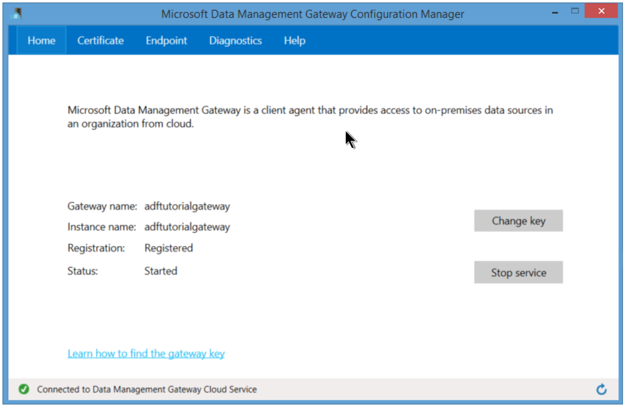
Gateway for On-Prem
Notes:
Activities: https://azure.microsoft.com/en-us/documentation/articles/data-factory-create-pipelines/
CreateHDICluster.txt:
{
"name": "HDInsightOnDemandLinkedService",
"properties": {
"type": "HDInsightOnDemand",
"typeProperties": {
"version": "3.1",
"clusterSize": 1,
"timeToLive": "00:30:00",
"linkedServiceName": "StorageLinkedService"
}
}
}

Slide 38
Lab:
Create the Linked Services
Notes:
Open the ADF Student Workbook file from your \Resources folder
Follow the steps for Lab 3

Slide 39
4: Create Datasets
Named reference or pointer to data
Notes:
Main Dataset Document Site: https://azure.microsoft.com/en-us/documentation/articles/data-factory-create-datasets/

Slide 40
Dataset Concepts
{
"name": "<name of dataset>",
"properties":
{
"structure": [ ],
"type": "<type of dataset>",
"external": <boolean flag to indicate external data>,
"typeProperties":
{
},
"availability":
{
},
"policy":
{
}
}.
Notes:
https://azure.microsoft.com/en-us/documentation/articles/data-factory-build-your-first-pipeline-using-editor/
AzureBlobOutput.txt:
{
"name": "AzureBlobOutput",
"properties": {
"type": "AzureBlob",
"linkedServiceName": "StorageLinkedService",
"typeProperties": {
"folderPath": "data/partitioneddata",
"format": {
"type": "TextFormat",
"columnDelimiter": ","
}
},
"availability": {
"frequency": "Month",
"interval": 1
}
}
}

Slide 41
Lab:
Create Datasets
Notes:
Open the ADF Student Workbook file from your \Resources folder
Follow the steps for Lab 4

Slide 42
5. Create Pipelines
Logical Grouping of Activities
Notes:
Main Pipeline Documentation: https://azure.microsoft.com/en-us/documentation/articles/data-factory-create-pipelines/

Slide 43
Pipeline Concepts
{
"name": "PipelineName",
"properties":
{
"description" : "pipeline description",
"activities":
[
],
"start": "<start date-time>",
"end": "<end date-time>"
}
}
Notes:
https://azure.microsoft.com/en-us/documentation/articles/data-factory-build-your-first-pipeline-using-editor/
Activities: https://azure.microsoft.com/en-us/documentation/articles/data-factory-create-pipelines/

Slide 44
Lab:
Create Pipeline(s)
Notes:
Open the ADF Student Workbook file from your \Resources folder
Follow the steps for Lab 5

Slide 45
6. Manage and Monitor
Scheduling, Monitoring, Disposition
Notes:
Main Concepts: https://azure.microsoft.com/en-us/documentation/articles/data-factory-monitor-manage-pipelines/

Slide 46
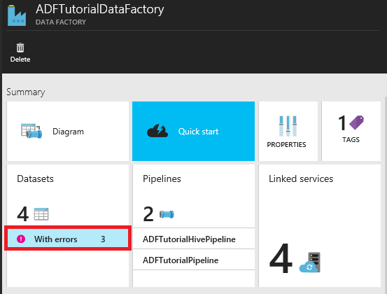
Locating Failures within a Pipeline
Notes:
PowerShell script to help deal with errors in ADF: http://blogs.msdn.com/b/karang/archive/2015/11/13/azure-data-factory-detecting-and-re-running-failed-adf-slices.aspx

Slide 47
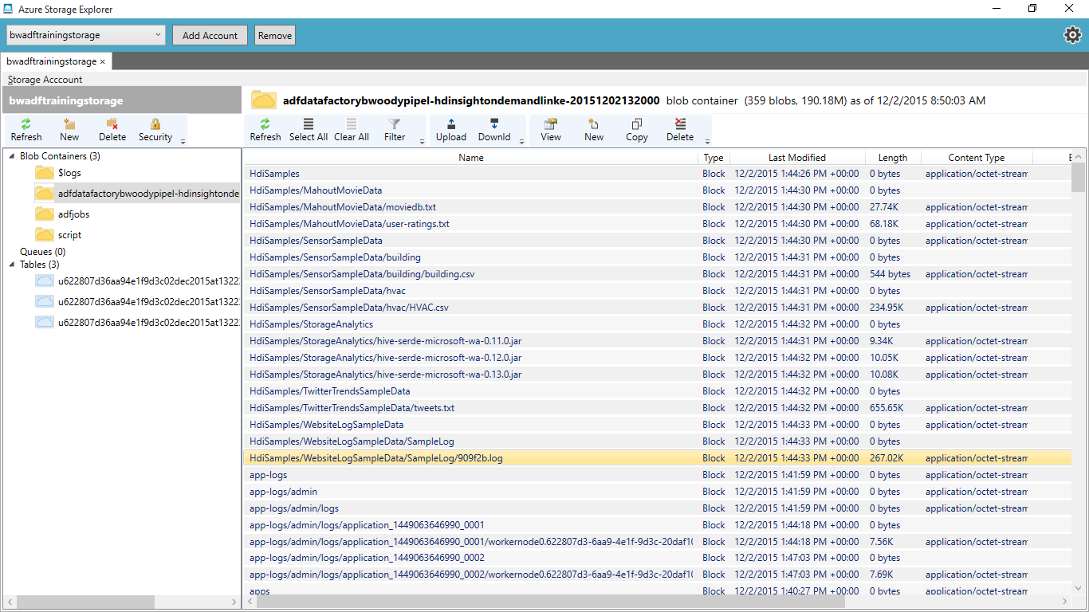
Notes:
PowerShell script to help deal with errors in ADF: http://blogs.msdn.com/b/karang/archive/2015/11/13/azure-data-factory-detecting-and-re-running-failed-adf-slices.aspx

Slide 48
Lab:
Monitor Pipeline(s)
Notes:
Open the ADF Student Workbook file from your \Resources folder
Follow the steps for Lab 6

Slide 49
Understand ADF and its constructs
Implement an ADF Pipeline referencing Data Sources and with various Activities
Understand how HDInsight can be used to process data
Understand the HIVE language and how it is used
Notes:
Questions?

